Slide 1
Hand-Written-Digit
Image Reading
Group 9
COMPANY NAME

Slide 2
01
Group 9 Handwritten Digits

Slide 3
Process
Before creating the model, we needed to gather the handwritten numbers from the group.
In which all team members were to submit their handwritten numbers into a jpg or png and uploaded into a GitHub repository that was created within the Group.
Each team member has different ways of writing their numbers.

Slide 4
02
Gather Other Group’s Handwritten Digits

Slide 5
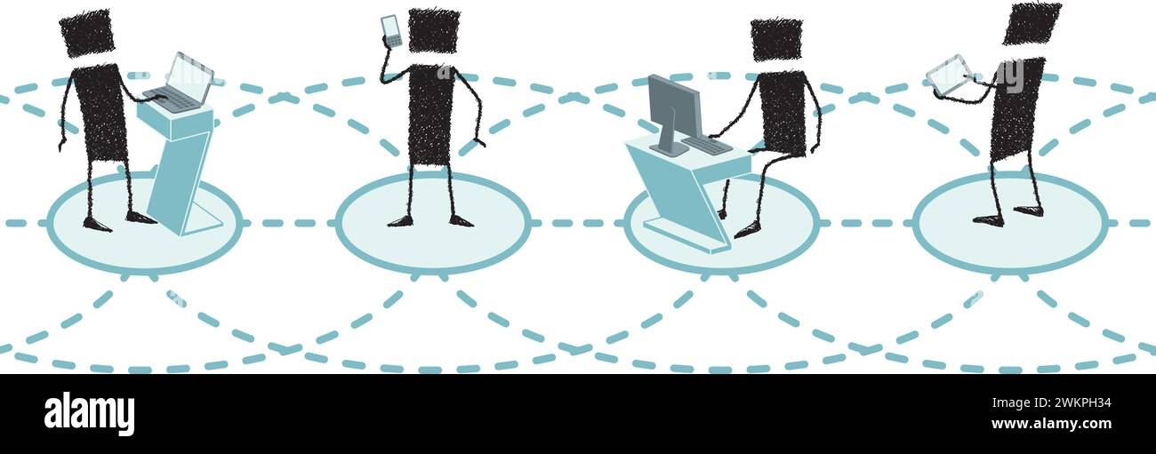
Process
Once other groups have submitted their digital handwritten into a Github repository, we download the handwritten digits and start to implement them with our handwritten digits.
Once all the handwritten digits have been acquired, we start to design the training and build the NN (Neural Network) using Pytorch and a reference code that was given to the class.

Slide 6
03
Implementing Neural Network

Slide 7
04
Training the Data

Slide 8
05
Test the Trained Model

Slide 9
06
Adding Weights and Hidden Paths

Slide 10
07
Making the Training Model Accurate

Slide 11
08
Test the Revised Trained Model

Slide 12
Questions?

Slide 13
THANK YOU
COMPANY NAME

